Slide 1
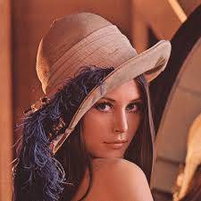
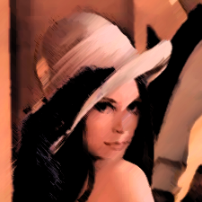
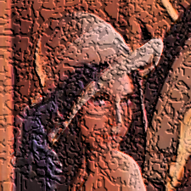
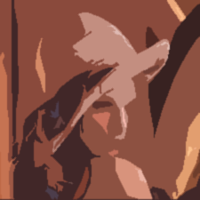
Image Processing with MATLAB
16-720 TA: Wen-Sheng Chu
wschu@cmu.edu
Aug 28th, 2014

Slide 2
Outline
Introduction
Image processing using Matlab
Video processing
References

Slide 3
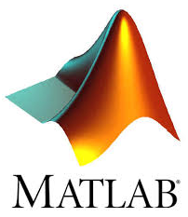

1. Introduction
The MATrix LABoratory
Dynamically typed language
Variables require no declaration
Create them just by initialization (x=10;)
All variables are treated as matrices
Scalar: 1×1 matrix; Vector: N×1 or 1×N matrix
Calculations are much faster
Advantages
Fast implementation and debugging
Natural matrix operation
Powerful image processing toolbox

Slide 4
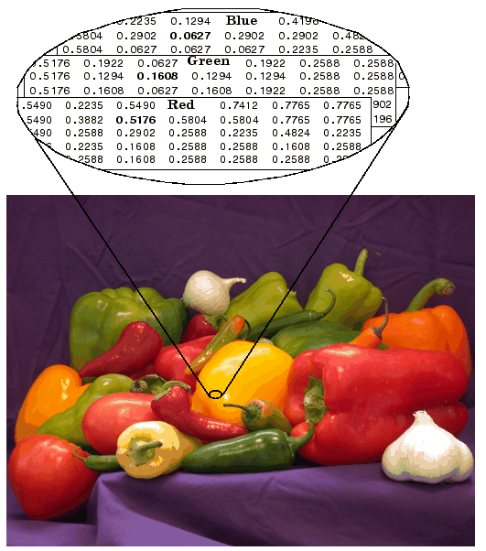
2.1 Image Data Structure
Image as matrices
Gray image: m × n
RGB image: m × n × 3
Format:
[0, 255] uint8
[0, 1] double
I(1,1,3)
I(1,1,1)
I(1,n,3)
m
I(m,n,3)
n
I(m,n,1)
Notes:
Manipulating an image is just the same as manipulating a matrix in Matlab.

Slide 5
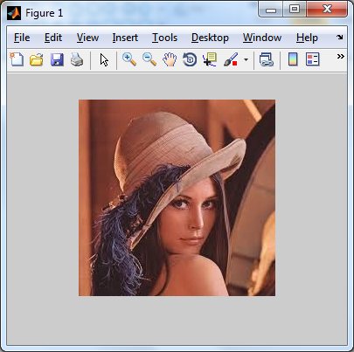
2.2 Image Import / Export / Display
% Read image (support bmp, jpg, png, ppm, etc)
I = imread('lena.jpg');
% Save image
imwrite(I, 'lena_out.jpg');
% Display image
imshow(I);
% Alternatives to imshow
imagesc(I);
imtool(I);
image(I);

Slide 6
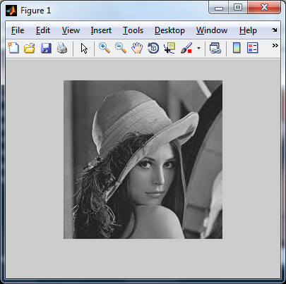
2.3 Image Conversion
% Type conversion
I1 = im2double(I);
I2 = im2uint8(I);
% Convert from RGB to grayscale
I3 = rgb2gray(I);

Slide 7

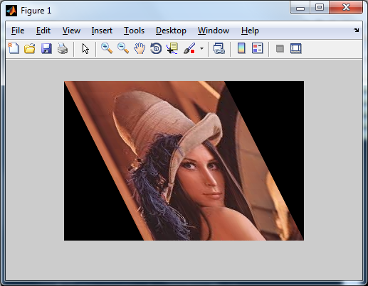
2.4 Image Operations
% Resize image as 60% smaller
Ires = imresize(I, 0.6);
% Crop image from user’s input
imshow(I);
Rect = getrect;
Icrp = imcrop(I, Rect);
% Rotate image by 45 degrees
Irot = imrotate(I, 45);
% Affine transformation
A = [1 0 0; .5 1 0; 0 0 1];
tform = maketform('affine', A);
Itran = imtransform(I, tform);
Notes:
What you have implemented in hw0 can be done in three lines in Matlab.

Slide 8
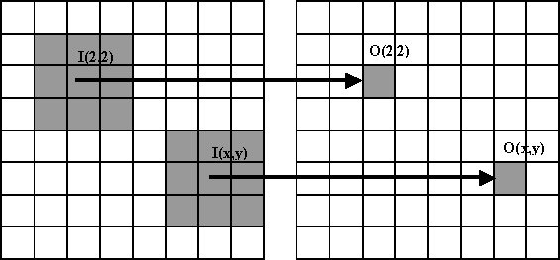
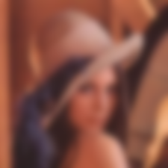

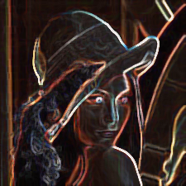

2.5 Image Filtering / Convolution
A filter (or called mask, kernel, neighborhood) is N×N matrix.
Filters help us perform different kinds of operations:
Blurring Sharpening Edge detection Noise removal

Slide 9
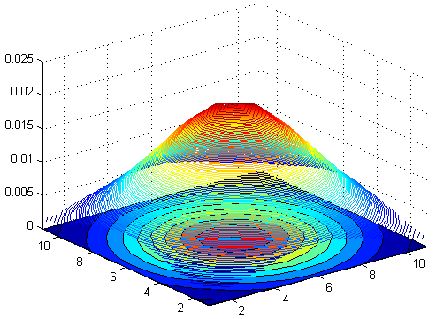
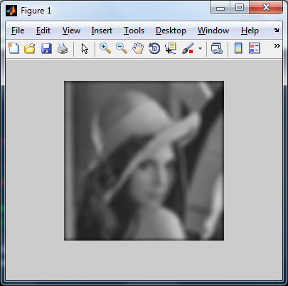
2.5 Image Filtering: Blurring
% Create a 11x11 Gaussian filter
f = fspecial('gaussian',11,3);
% Filtering on gray image
Ig = im2double(rgb2gray(I));
If = filter2(f, Ig);

Slide 10

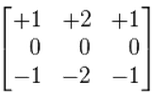
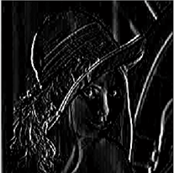
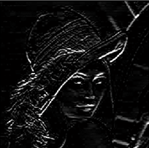
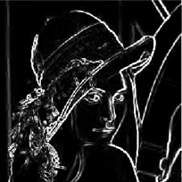
2.5 Image Filtering: Edge Detection
% More discussions will be given in class
% Sobel edge detection by filtering
fx = [-1,0,1; -2,0,2; -1,0,1];
fy = [ 1,2,1; 0,0,0; -1,-2,-1];
Ix = filter2(fx, Ig);
Iy = filter2(fy, Ig);
Isob = Ix.^2 + Iy.^2;
fx
fy
Ix
Iy
Isob

Slide 11
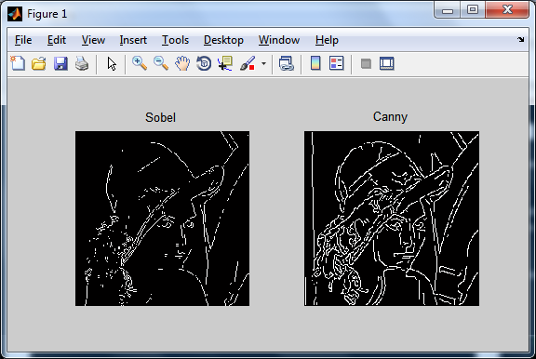
2.5 Image Filtering: Edge Detection
% More discussions will be given in class
Ig = im2double(rgb2gray(I));
Isob = edge(Ig, 'sobel'); % Sobel edge detection
Ican = edge(Ig, 'canny'); % Canny edge detection

Slide 12

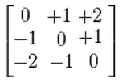
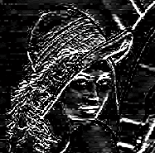
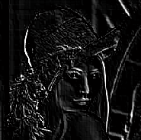
2.5 Image Filtering: Customized
% Customize a stronger edge detector
f1 = [3,10,3; 0,0,0; -3,-10,-3];
I1 = filter2(f1, Ig);
% Customize a diagonal edge detector
f2 = [0,1,2; -1,0,1; -2,-1,0];
I2 = filter2(f2, Ig);
f1
f2
I1
I2

Slide 13
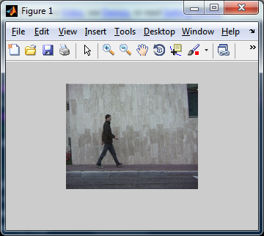
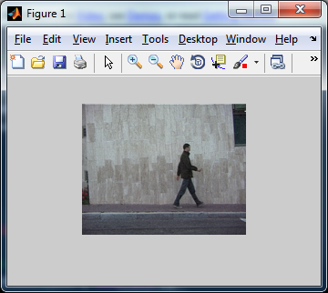
3. Video Processing: Read Videos
% Construct video object to read video data
vidobj = VideoReader('walk.avi');
% Display frame-by-frame
for iFrm = 1 : vidobj.NumberOfFrames
I = read(vidobj, iFrm); % Read frame
imshow(I);
pause(.1);
end

Slide 14
3. Video Processing: Write Videos
% Construct video object to write video data
vidout = VideoWriter('walk_out.avi’);
% Start writing content
open(vidout);
for iFrm = 1 : nFrm
writeVideo(vidout, I);
end
close(vidout);

Slide 15
4. References
More tutorials
Matlab course @ ETHZ (http://goo.gl/W2jmZJ)
Introductory Digital Processing @ IIT (http://goo.gl/U0osD2)
Open source CV algorithms with Matlab interface
VLFeat (http://www.vlfeat.org/)
Piotr Dollar’s toolbox (http://vision.ucsd.edu/~pdollar/toolbox/)
Mexopencv (http://www.cs.stonybrook.edu/~kyamagu/mexopencv/)
Optimization
CVX (http://cvxr.com/cvx/)

Slide 16
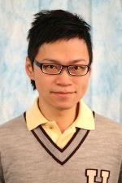
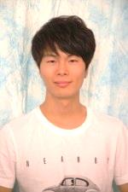
Follow-up
Slides and codes will be online
Blackboard → F14-Computer Vision → Course Documents
Ask questions on Discussion Board
Office hours
Wen-Sheng Chu (wschu@cmu.edu)
Tuesdays 5-6pm
EDSH 200
Han Joo (hanbyulj@cs.cmu.edu)
Fridays 2-3pm
EDSH 201

